Slide 1
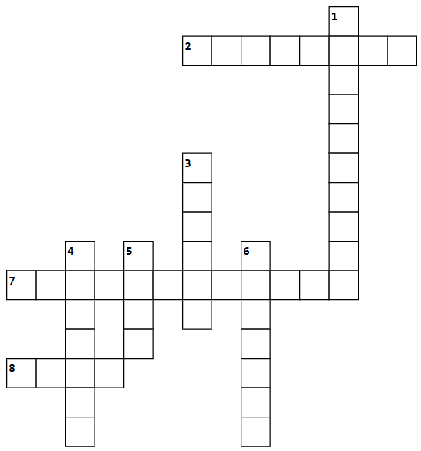
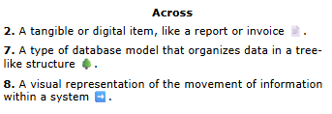
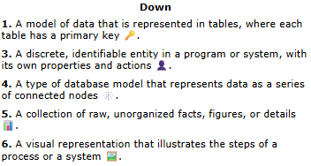
Icebreaker
Notes:
[2min]
Instructor description:
As apprentices join the call display this slide and play music. Encourage suggestions in the chat.

Slide 2
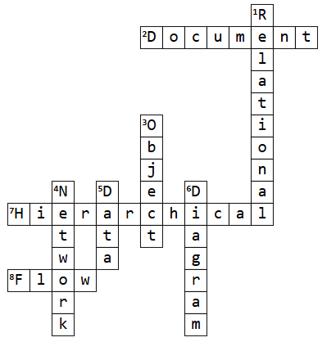
Icebreaker
Notes:
[<1min]
Instructor description:
Flash up answers, thanking those who participated

Slide 3
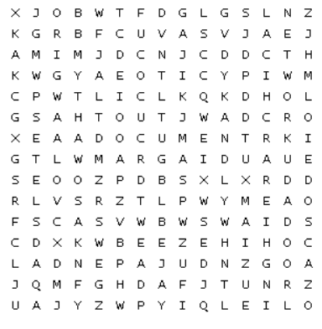
Icebreaker
Notes:
[<1min]
Instructor description:
Flash up answers, thanking those who participated
Data
Flow
Object
Diagram
Hierarchical
Relational
Document
network

Slide 4
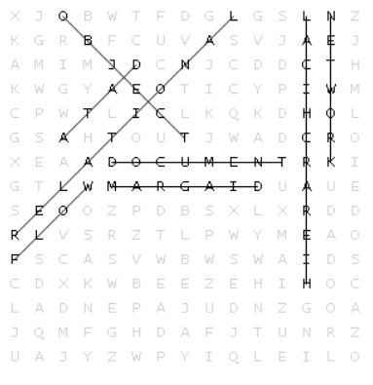
Icebreaker
Notes:
[<1min]
Instructor description:
Flash up answers, thanking those who participated
Data
Flow
Object
Diagram
Hierarchical
Relational
Document
network

Slide 5
Stop the Schema-nanigans! Data Modelling for Sanity
Session Instructor: Joel Mendes
Notes:
[<1min]
Instructor description:
Welcome to the session.
Talk-track:
Welcome to the session, the “Stop the Schema-nanigans!” put on for Coach Community to specifically cover the Data Modelling competency.
This slide is here to make sure you have all turned up to the right session.

Slide 6
Stop the Schema-nanigans!
Agenda
Welcome to the show
Show notes
Why Bother Modelling?
See the “Collection” on the runway
Backstage
Review
Notes:
[2min]
Instructor description:
Outline the planned structure and activities for the session.
Talk-track:
So the plan for today’s session is for me to do a little welcome and introduction, for those of you who don’t know who I am and are not sure what you have signed up for.
Then I’ll provide everyone with the “show notes” so you know the specific objectives we plan to cover in this session.
Our first activity is a look into why we would model the data in the first place, so looking for responses and experience you have from Delivery, working with apprentices and the underlying reasons we carry out this work.
Next I will present some examples from the data modelling “collection” so you can see what these look like in practice and know why/when you might use them.
The last activity is to, hopefully, have a go at least one of the behind the scenes tools, so you can support your apprentices to get stuck in.
Finally, we’ll review the session and try and answer any final questions.
In terms of interaction
Please remember to keep yourself on mute when not sharing
Use the raise hand feature or put questions in the chat, I am monitoring both
And I would encourage everyone to actively participate, so you get the most from the session
Any problems with the tools and we go through today, let me know and we’ll try and find a fix (probably after the show)
And I’ll be sharing links in the chat as and when you need them.

Slide 7

Joel Mendes
Senior Instructor, Advanced Programmes
2.5 years with Multiverse
Helped build and now deliver Applied Data Engineering
Genuinely did compete in a Bodybuilding competition.
Notes:
[1min]
Instructor description:
Introduce instructor
Talk-track:
I hope all of you enjoyed the session description and bio, if you didn’t you may have found the agenda a little confusing and missed all the modelling jokes.
Needless to say, it was written with the support of Gemini
The key points about me are that I am a Senior Instructor, working across Advanced Programmes. I specifically focus on Data Engineering, so Data Modelling very much fits within my wheelhouse.
I’ve been at Multiverse for over 2.5 years now
And yes, I really did compete in a bodybuilding competition (though I did not star in the Zoolander movie)

Slide 8
Show Notes

Slide 9
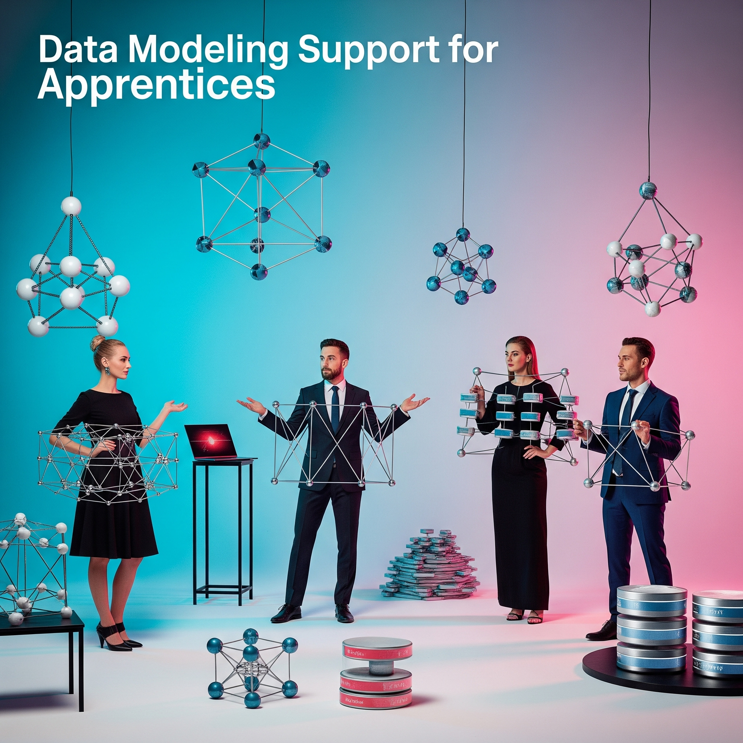
Learning Objectives
To understand the need for data modelling and be able to communicate its benefits.
Have a high level understanding of different data modelling approaches.
Be able to guide apprentices through different options for modelling and tools.
1
2
3
Notes:
[1min]
Instructor description:
Highlight to whole group the goals of the session
Talk-track:
Read through objectives on the slide.

Slide 10
Why Bother Modelling?

Slide 11
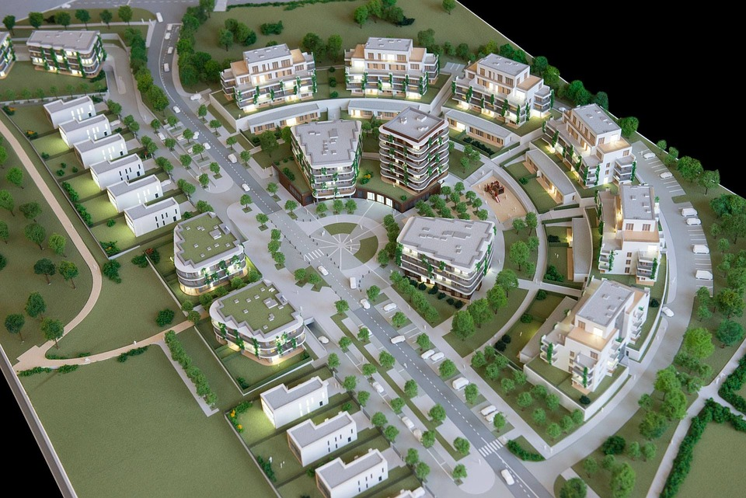

Where would you rather live?
Would you rather live here?
Or here?
Notes:
Slide time: 2 min
Instructor description:
To emphasise the need for a plan, regardless of what that plan is.
Talk-track:
Before answering that question lets first …
consider these two images.
[Click to reveal images, one a at time]
Which city would you prefer to live in - and why? In the chat (left or right).
Pick 1 or 2 apprentices to share their feedback.
Just like city planners design the layout of roads, public utilities, and zones to organize a city effectively, data modelers design database schemas which organize and optimize data storage.
A well organized and structured data system is like an intelligently planned city - easy to navigate around and get to what you need.
If you don’t organize your data you’ll end up with the data equivalent of the image on the right - poor planned and impossible to find your way around!
That’s why structure and design is so important. And that, is where schemas come in.
Image sources:
https://pixabay.com/photos/arq-town-planning-1a-2645763/
https://pixabay.com/photos/traffic-city-road-street-rain-7272520/

Slide 12

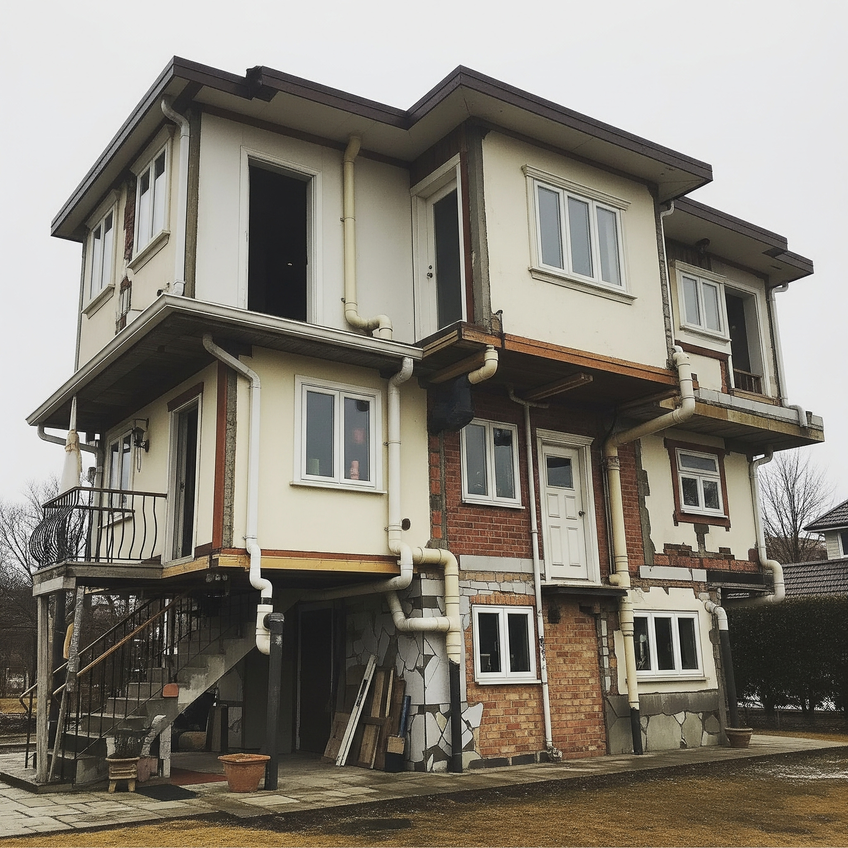
Why Bother Modelling?
To start thinking about answering this question, I would like to pose some different questions:
"What happens if you don't data model?"
"What problems will you likely encounter?"
"How will this impact your organisation and future work?"
To replace image - Select image and then click “Replace image” in menu above
Notes:
[5min]
Instructor description:
Establish how we communicate the value of Data Modelling to our apprentices.
Talk-track:
So we’ve seen why we would want to have a data model but how do we communicate this to apprentices, and in turn how do they communicate this to their stakeholders?
It can be useful to think about the opposite of data modelling.
I.e. what happens if we don’t data model?
If you were building a house, without a blueprint/plan/guide, and just started laying bricks you might end up with walls all over the place, rooms that don’t make sense and stairs to nowhere.
Then you can connect this to the problems that you will likely encounter? [what problems will might you encounter without a data model?]
Can you imagine trying to find some really urgent information without any plan or data model, similar to trying to find a bathroom in our higgledy piggledy house.
Or maybe you might have worse data integrity with the same bit of information stored in multiple places, similar to having multiple kitchens in this house, which one has the right set of ingredients.
Then we need to connect these problems to business impact? [what would be the impact on our business of poor data integrity and lack of organisation?]
You’re creating technical debt for your business, without making major revisions to the structure of the house you’re creating bigger and bigger problems for the future.
Wasted time and resource, the investment you make into finding the right room, or quickest route, or most up-to-date ingredients in the kitchen could’ve been reduced and taken less effort
Going to struggle to scale, at some point you won’t be able to effectively add rooms and created connections between them, the house will no longer be fit for purpose.

Slide 13
The “collection” and the runway

Slide 14

The secret
What you must learn is that these rules are no different than the rules of a computer system. Some of them can be bent. Others can be broken. Understand?
Is there an inherent structure within the data?
Is there a preferred structure for our primary business purpose?
Are there any optimal structures associated with storage/processing needs?
To replace image - Select image and then click “Replace image” in menu above
Notes:
[5min]
Instructor description:
We need to introduce the idea to people that there is more than one “right” data model.
Talk-track:
Anyone recognise the quote?
This is what Morpheus says to Neo in an attempt to “Free his mind”
The point here is that there are rules, but you are able to break them and so we can immediately dispel the notion that there is one right data model that we’re in search of when trying to model our data.
Instead we’ll approach from a few different angles [click]:
Is there an inherent structure within the data?
Is there a preferred structure for our primary business purpose?
Are there any optimal structures associated with storage/processing needs?

Slide 15

Illustration
Let’s take an example:
Think about your music collection how is it organized?
Is there an inherent structure within the data?
Is there a preferred structure for our primary business purpose?
Are there any optimal structures associated with storage/processing needs?
Notes:
[10min]
Instructor description:
Lead people through a discussion to highlight the different ways that a dataset could be organised.
Talk-track:
Let’s look at an example that I think most of you will be familiar with but is also deeply personal. Music!
I would like everybody to think about their music collection, how do you organise it? (hands up for this one.)
anyone organise their music differently?
Are there any alternative ways of organising it?
Why do you organise your music that way?
Now we’ve looked at how you all organise your own music [click] let’s go back to those questions that should guide us.
Instead we’ll approach from a few different angles:
Is there an inherent structure within the data?
Several eg. artist, album, music label, genre, etc.
Is there a preferred structure for our primary business purpose?
If our business was as a streaming service, then our primary focus is songs. We’re serving songs.
Are there any optimal structures associated with storage/processing needs?
Due to the velocity of our data storing tracks in an easily searchable fashion is going to be vital, this question gets to the meat of the problem and should be something we think about throughout our search.

Slide 16
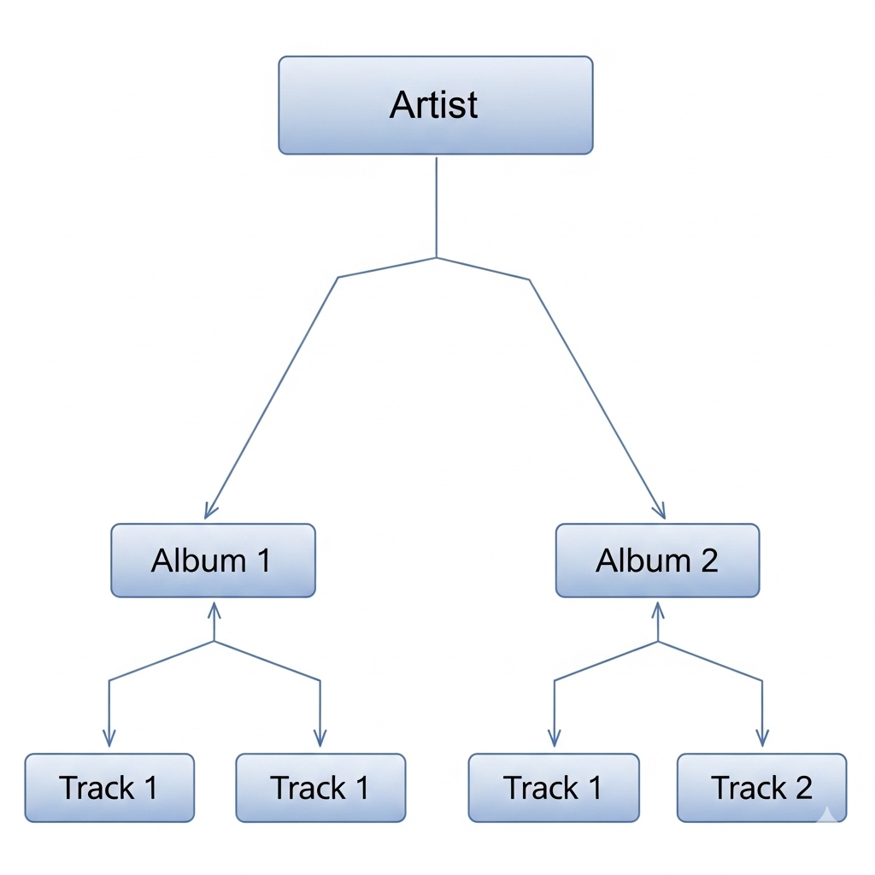
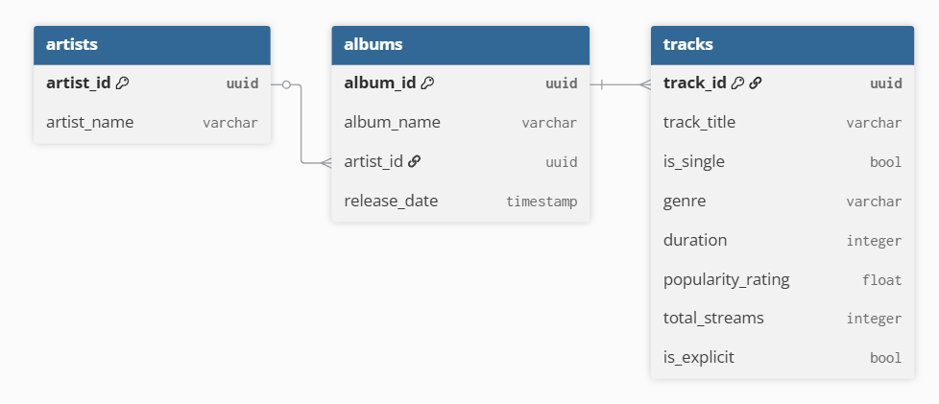
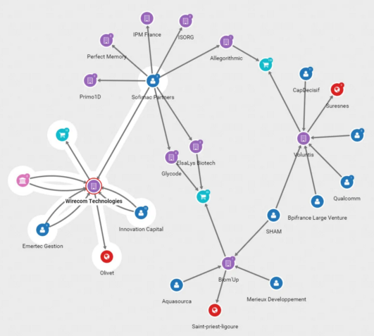
Our models
A hierarchical model eg. “record collection”.
An object model eg. “streaming”
A Network model eg. “social”
Notes:
[10min]
Instructor description:
Introduce the actual data models and talk through some advantages and disadvantages
Talk-track:
Let’s look at some of our models, advantages and disadvantages and how they might be implemented.
First up:
A hierarchical model could be used to organise our data, this might be thought of as our “record collection”.
Advantages: are the logical structure, that appears to be inherent to the data and is easy to communicate to stakeholders.
Disadvantages: harder to search for data without the full relationship, you have to create additional rules for how duets and collaborations are handled, this may lead to redundancy if the track gets stored under both artists, you are guaranteed redundancy when you consider ‘best of’/’greatest hits’/compilations. Reorganising the data in the future could be difficult.
In action: this could be the file system on a computer, sharepoint, AWS EFS, JSON documents even a RDBMS (with strict rules)
Hierarchical models are best suited for data that has a strict parent-child relationship.
An object model is a more traditional “database” style model, where we store our albums, artists and tracks as different objects or entities and link them together with primary-foreign key relationships or embed them within each other.
Advantages: easier to locate the data, improved redundancy
Disadvantages: harder to communicate to stakeholders, requires longer time to understand and access, more complex to organise and implement
In action: this will be a database of somekind, however it is not necessary a SQL database and the final structure you chose will heavily impact the implementation. Ie. this could be a document database. Postgres, Azure SQL database, MS SQL server, AWS RDS, AWS redshift, GCP BigQuery, but also MongoDB, CouchDB, etc.
This is a very developed model with plenty of options to suit different data, so is going to work well in lots of different situations.
A network model is not particularly suitable for the data we’re looking at, that is because a network model fits with highly connected data. There are loads of connections within our data eg. “The Chain” and “Everywhere” are connected to the Album “Rumours” but a track is going to be connected to an album (maybe a couple if it’s part of a compilation or a best of) but this is not what we mean by highly connected. If we introduced user data into the mix then a Network model would be ideal for modelling “like”, “shares” and “follows”. A user can like many tracks, follow many artists and share many albums.
Advantages: ideal for looking at relationships between specific data points, perfect for modelling highly connected data (many-to-many)
Disadvantages: less efficient for traditional analysis i.e. aggregating attributes of data points
In action: specialist network databases and querying language like Neo4j or Amazon Neptune
Ideal for data that is highly connected many-to-many and the focus of any analysis is on the connections between records.

Slide 17
Backstage

Slide 18
Tools of the trade
Excel
Lucid chart
Dbdiagram
Synthetic data
Postgres
mongodb
Notes:
[15min]
Instructor description:
Walkthrough some of the practical tools
Talk-track:
Let’s look at some of the tools we can use to get apprentice’s hands on with their data.
Most of the resources are now on github: https://github.com/jmendes16/data_modelling

